Slide 1
PROVOST’S UNDERGRADUATE
FELLOWSHIP
(PUF)
INFORMATION SESSION
UC Davis Undergraduate Research Center

Slide 2
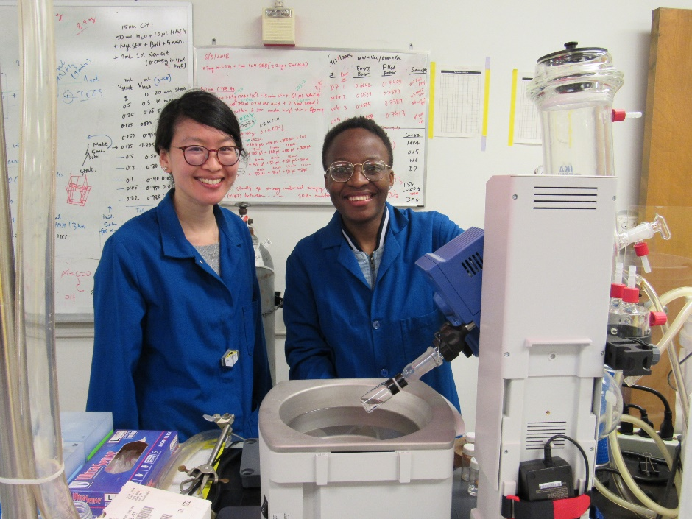
What is the Provost Undergraduate Fellowship?
PUF supports undergraduate students doing research or creative projects under the guidance of UC Davis faculty members.
Maximum awards are $1,500
Funds are transferred into an account in the faculty sponsor’s department for support of the recipient’s project.

Slide 3
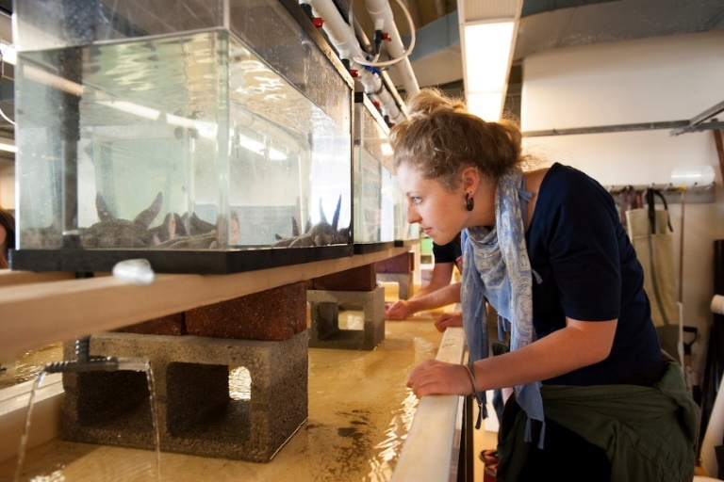
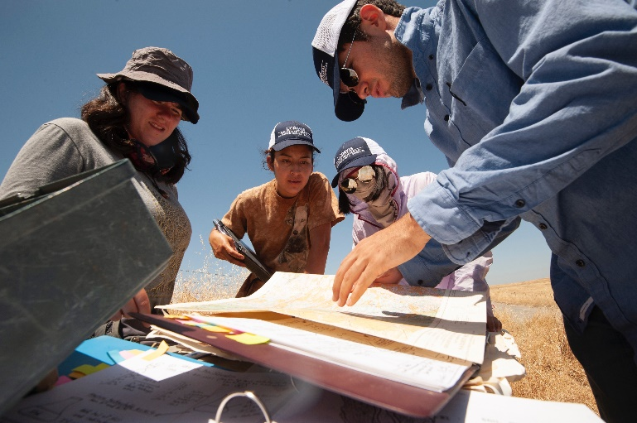
Who is eligible?
Full or part time registered UC Davis undergraduate
Good academic standing
Meet satisfactory academic progress
Enrolled during the quarters that the research is carried out
On continuing student status during the summer and enrolled in fall quarter to conduct summer research
Notes:
Undergraduate students are in good standing by:
Obtaining a GPA of 2.000 or above for each term and
Maintaining a cumulative GPA of 2.000 or above and
Maintaining a degree progress average of at least 12 units passed per quarter over all quarters of enrollment and
Accumulating no more than 16 course units graded as Incomplete.

Slide 4
APPLICATION DEADLINE
November 8, 2021
UPLOAD MATERIALS ON LINE NO LATER THAN 11:59 P.M.
UPLOAD PDF FILES ONLY
If you upload other document types (e.g. Word, PowerPoint) the reviewers will not be able to view them in your application file! Your application will be incomplete!
https://urc.ucdavis.edu/PUF

Slide 5
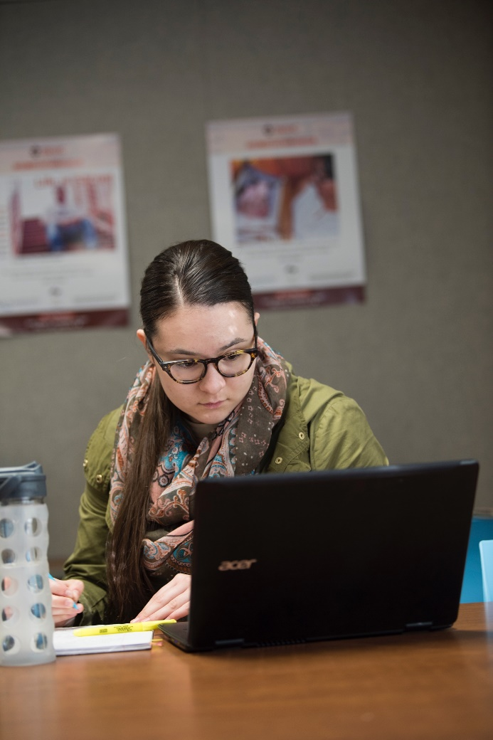
Preparing a Complete Application
THE SIX STEPS:
Application Cover Form
Proposed Project
Learning Potential
Budget Outline
UC Davis Transcripts
Letter of Recommendation

Slide 6
Online Cover Page
Fill in all fields of the application
Provide a brief (25 words or less) description of your proposed project. This gives the selection committee an “at a glance” idea of what your project is about
Indicate the dollar amount you are asking for under “Proposed Budget Amount”
You will need to indicate if any equipment (Cameras, recording equipment for example) is being requested or if human subjects are involved
STEP 1

Slide 7
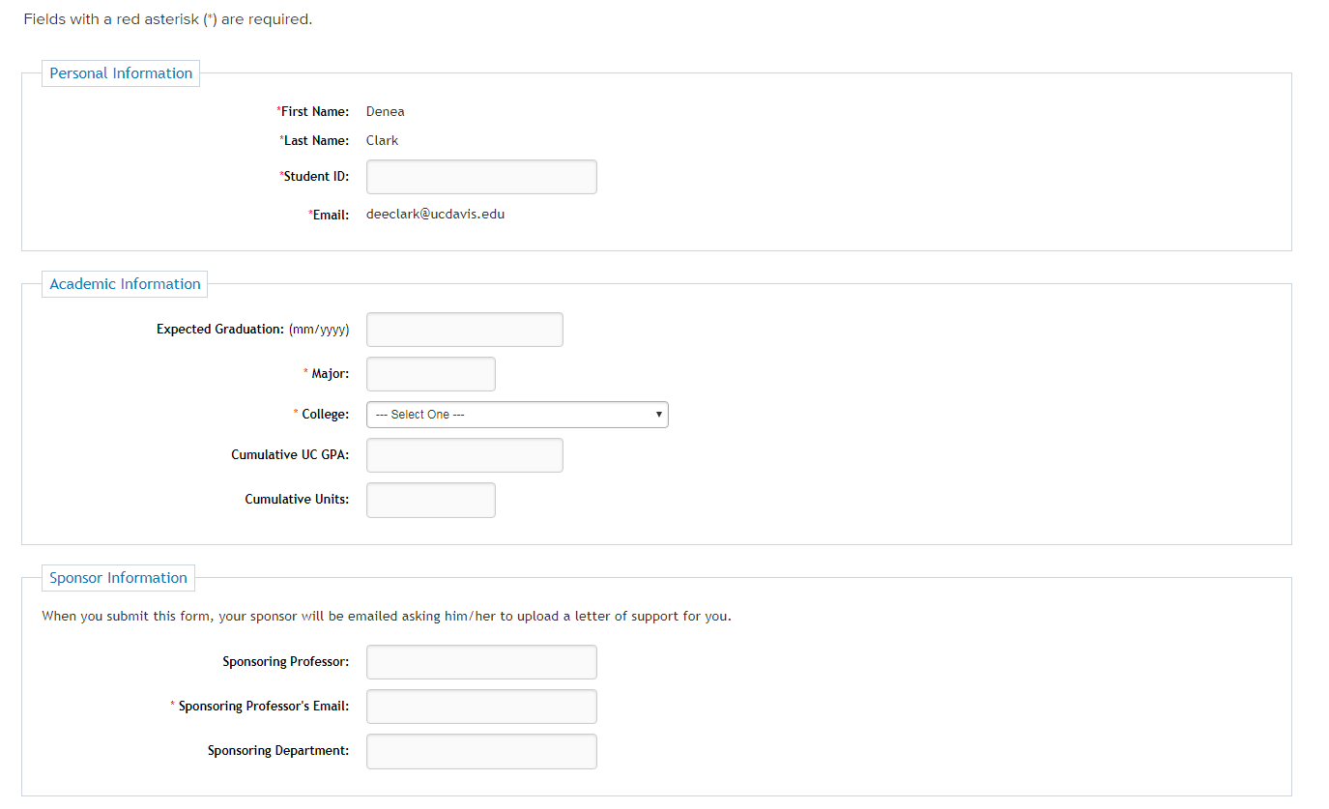
Online Cover Page

Slide 8
Proposed Project Format
Length: one page (single spaced, 12 point font, Times/New Roman, 0.5 to 1.0 inch margins.
Provide at least 3 research citations in the body of the narrative, and include a bibliography with full references
Citations/bibliography may be listed on the second page if necessary
STEP 2

Slide 9
Proposed Project
BACKGROUND: Discuss the context and background of the project within the research field
RESEARCH QUESTION: What is the central question or problem you are addressing? What are the goals?
METHODOLOGY: Include a brief account of approaches and methods you intend to use
TIME SCHEDULE: Include the time frame of when you plan to accomplish the work
SIGNIFICANCE: Describe the significance of the work—why is it important?
And citations, bibliography!
STEP 2

Slide 10
Administrative Approvals
If your project requires approvals for use of human subjects, vertebrate animals, radioactivity, etc. Include a sentence demonstrating your awareness of any needed approvals.
RESEARCH INVOLVING HUMAN SUBJECTS MUST GO THROUGH IRB REVIEW!
Does Human Subjects research include interviews and surveys? YES! Please include a draft of the survey or interview with your project proposal. (You can add additional page(s)to your project proposal PDF to include the draft survey/interview)
What is the IRB? The Institutional Review Board (IRB) Administration is committed to following the federal regulations to protect the rights and welfare of human subjects involved in research conducted under the auspices of the University of California,
Does a determination by the IRB or other approvals need to be completed before applying? NO! However, funds for the approved proposals will not be transferred until IRB determination, if required, is emailed to the URC.

Slide 11
Learning Potential
Discuss the significance of this experience in relation to your academic and/or career plan
Why did you select this project?
What will you get from it?
Be specific, be personal
Length: maximum 200 words
STEP 3

Slide 12
Budget Outline and Justification
Awards may not exceed $1,500
Travel requests should reflect actual transportation costs (not per diem)
Length: approximately 1 page
Budget items are usually items that are directly related to carrying out the research project
STEP 4

Slide 13
Budget Outline and Justification
Books are typically not funded because you can get them from Inter-library loan
Equipment purchases must be justified and will be retained by PUF
Equipment/supplies commonly found in the research environment require justification (including computer software). Items like test tube racks or SPSS software is typically not funded.
STEP 4

Slide 14
Non-Funded Budget Items
Items that are NOT funded:
Memberships
Salaries
Parking Permits
Travel to present at or attend a conference (apply for the Undergraduate Travel Award
)
STEP 4

Slide 15
UC Davis Transcripts
Go to: http:// myucdavis.edu. Click on “myrecords”, then “academics” and select “unofficial transcripts”
Unofficial transcripts will work for this purpose. Do NOT upload official 3rd party protected transcripts!
Use your browser’s print feature to make a pdf and save to your computer so it’s ready for you to upload into your application
STEP 5

Slide 16
Letter of Recommendation
Once you submit your application, an email will be sent to your sponsoring professor asking them to upload the letter of support using a specific link.
Professors must upload the letters of recommendation by Thursday, Nov 11, 2021, 11:59 p.m.
Therefore, you would be wise to ask them to get started on the letter well in advance of the PUF application deadline!
They will not be able to upload a letter until you submit your application.
The professor will also have to fill out the “Contracts and Grants” Analyst’s (or other finance contact) name and email address.
STEP 6
Notes:
If you haven’t asked yet, do now!

Slide 17
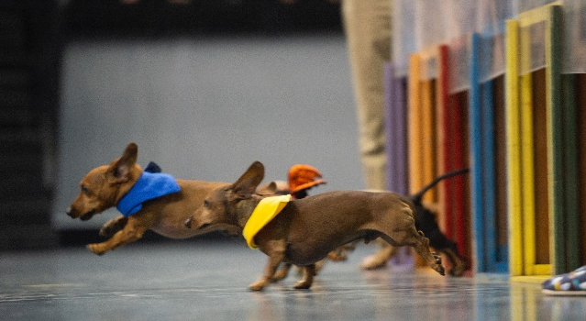
Selection Process
Each College will review applications from their own students
Each College’s Awards and Prizes Committee reads and ranks all proposals
Funding is awarded to the top applications from each College, as budget allows
Award letters are sent to students and sponsors with a cc: to the finance contact in the faculty’s department.

Slide 18
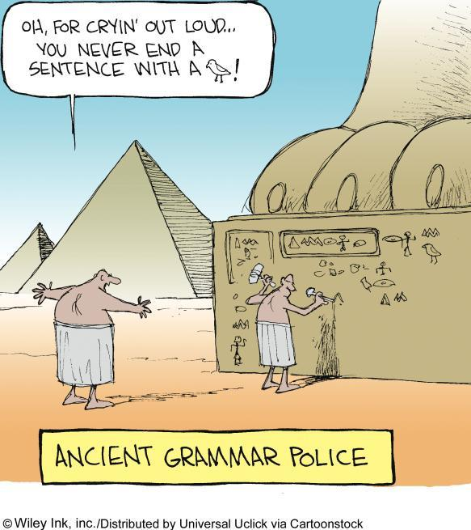
Selection Committee Tips
Proofread carefully
Lack of attention to this type of detail reduces overall confidence in your abilities.
Professor’s stated that many proposals were “incomprehensible” and they couldn’t understand “any of it”.
Be sure to give context to the proposal and state why it is important, what does it mean, what is the significance and/or is the idea new.

Slide 19
Selection Committee Tips
“Keep it nice and simple, well justified, well written”.
“Say it more plainly”.
“Explain the significance of why I should care.”
“Bad writing will demolish a good idea.”
Write “award proposals that are readable and comprehensible.”
“It is important to have a clear hypothesis and research goal.”

Slide 20
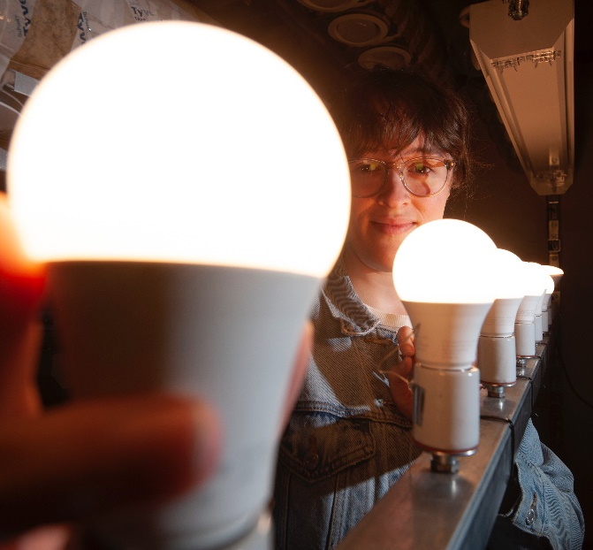
Reviewing some tips…
Follow directions
Write a clear proposal of high quality
Ask for the letter of recommendation well in advance of the deadline date
Only applications which are complete and submitted ON TIME will be accepted. (UPLOAD PDF’s ONLY!)
Submit early to allow yourself time to address any technical issues that might arise in the submission process.

Slide 21
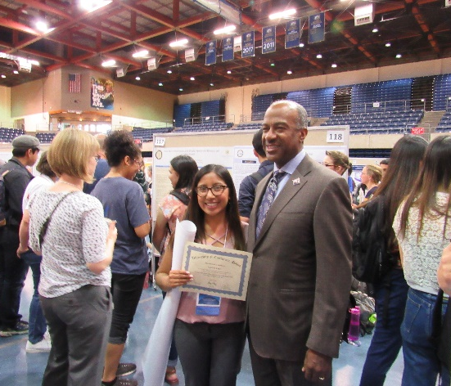
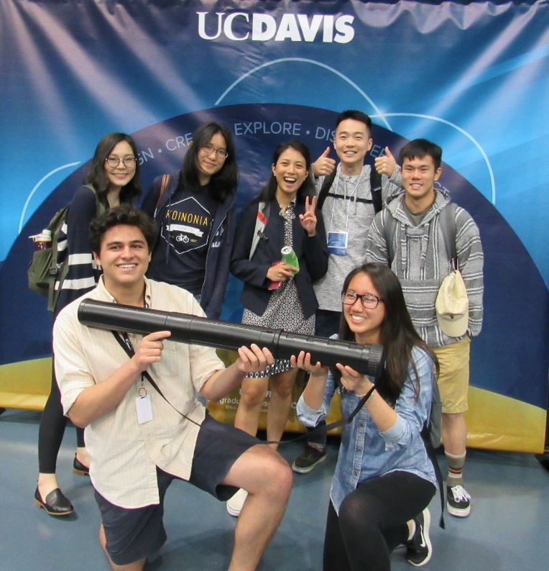
Expectations
Submit a final report at the end of the quarter in which the project is completed
Participate in PUF/undergraduate research outreach efforts by filling out an research experience survey.
Present your work at the annual Undergraduate Research Conference in spring quarter

Slide 22
QUESTIONS?
INFORMATION AND APPLICATION
https://urc.ucdavis.edu/PUF
CONTACT US
FOLLOW US
Student Community Center
Suite 2300, upstairs
M-TH – 9am-4pm
urc@ucdavis.edu
530-752-3390
URC.UCDAVIS.EDU
ucdavisurc
ucd_urc

